Slide 1
Testing a hypothesis

Slide 2

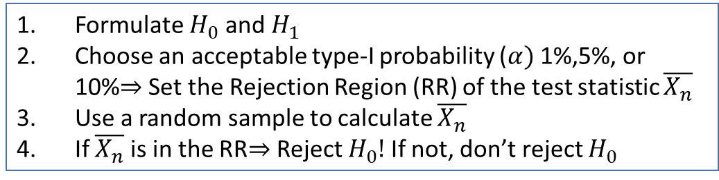
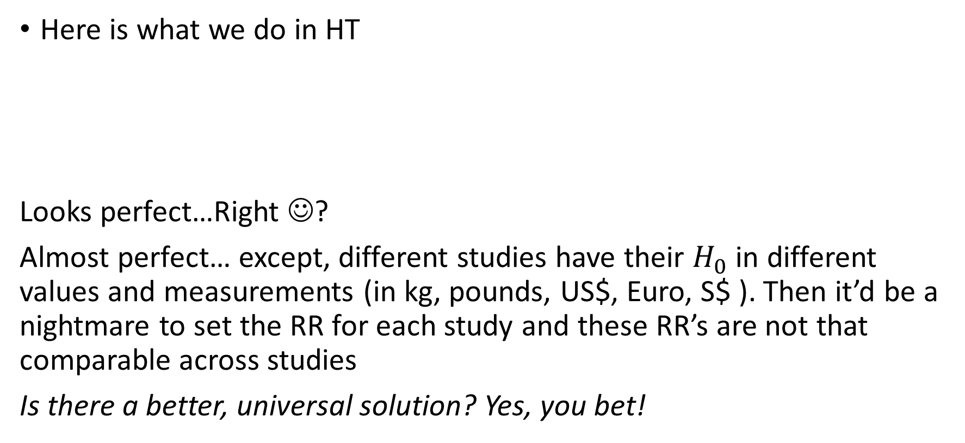
From the last videos
Here is what we do in HT
Looks perfect…Right ☺?
Almost perfect… except, different studies have their $H_{0}$ in different values and measurements (in kg, pounds, US$, Euro, S$ ). Then it’d be a nightmare to set the RR for each study and these RR’s are not that comparable across studies
Is there a better, universal solution? Yes, you bet!
Formulate $H_{0}$ and $H_{1}$
Choose an acceptable type-I probability ($α)$ 1%,5%, or 10%$⇒$ Set the Rejection Region (RR) of the test statistic $\overline{X_{n}}$
Use a random sample to calculate $\overline{X_{n}}$
If $\overline{X_{n}}$ is in the RR$⇒$ Reject $H_{0}!$ If not, don’t reject $H_{0}$

Slide 3
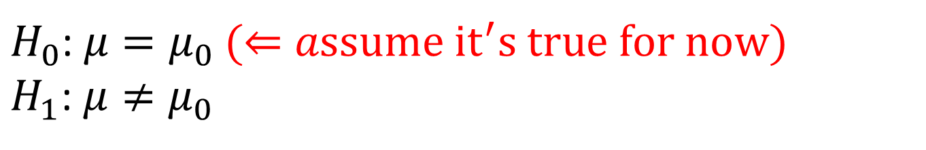
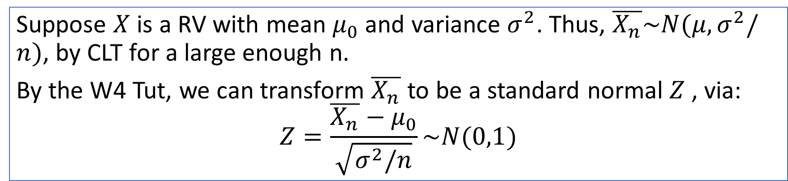
Standardized to standard normal
$H_{0}$: $μ=μ_{0} (⇐assume {it}^{′}s true for now)$
$H_{1}$: $μ≠μ_{0}$
Suppose $X$ is a RV with mean $μ_{0}$ and variance $σ^{2}$. Thus, $\overline{X_{n}}\sim N(μ,σ^{2}/n)$, by CLT for a large enough n.
By the W4 Tut, we can transform $\overline{X_{n}}$ to be a standard normal $Z$, via:
$$Z=\frac{\overline{X_{n}}−μ_{0}}{\sqrt{σ^{2}/n}}\sim N(0,1)$$
What this amounts to is, after this transformation, we can convert whichever test for population mean to one under the standard normal! (given a large sample)

Slide 4
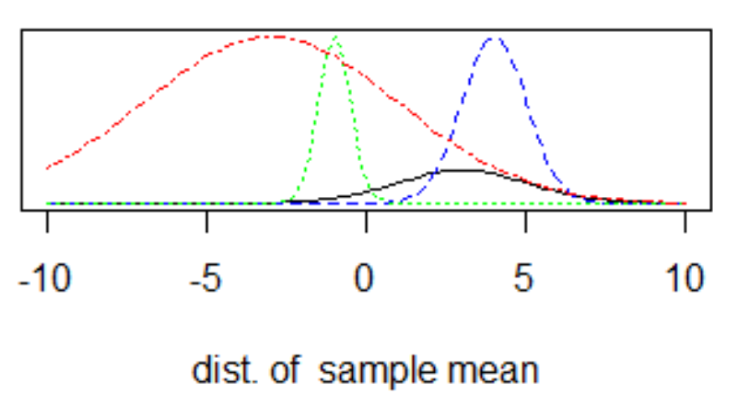
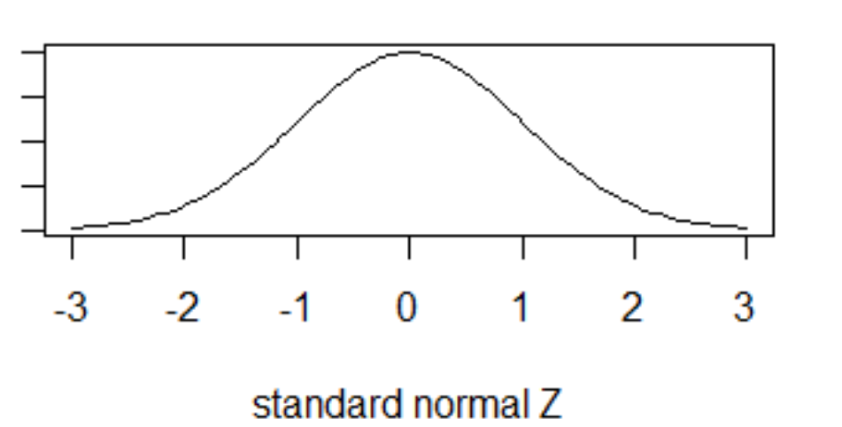

$$Z=\frac{\overline{X_{n}}−μ_{0}}{\sqrt{σ^{2}/n}}$$
(given H0 is true)
Let’s make some noise! CLT! CLT! CLT!

Slide 5
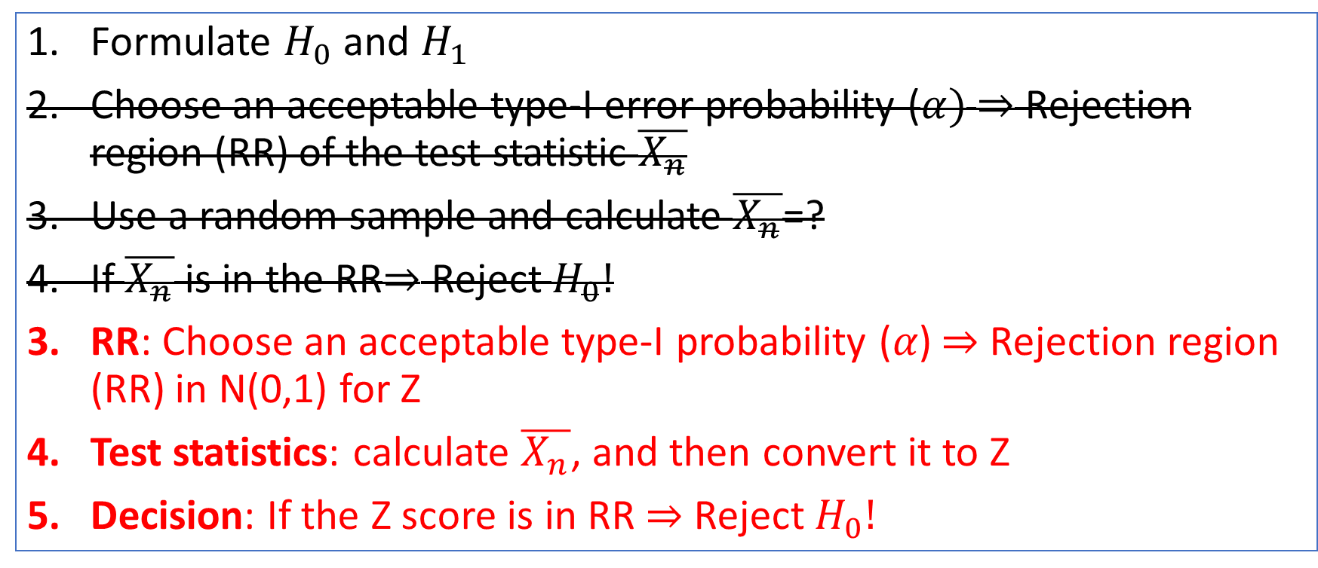
Simplified steps for HT
Formulate $H_{0}$ and $H_{1}$
Choose an acceptable type-I error probability ($α)$ $⇒$ Rejection region (RR) of the test statistic $\overline{X_{n}}$
Use a random sample and calculate $\overline{X_{n}}$=?
If $\overline{X_{n}}$ is in the RR$⇒$ Reject $H_{0}!$
RR: Choose an acceptable type-I probability (𝛼) ⇒ Rejection region (RR) in N(0,1) for Z
Test statistics: calculate $\overline{X_{n}}$, and then convert it to Z
Decision: If the Z score is in RR $⇒$ Reject $H_{0}!$

Slide 6
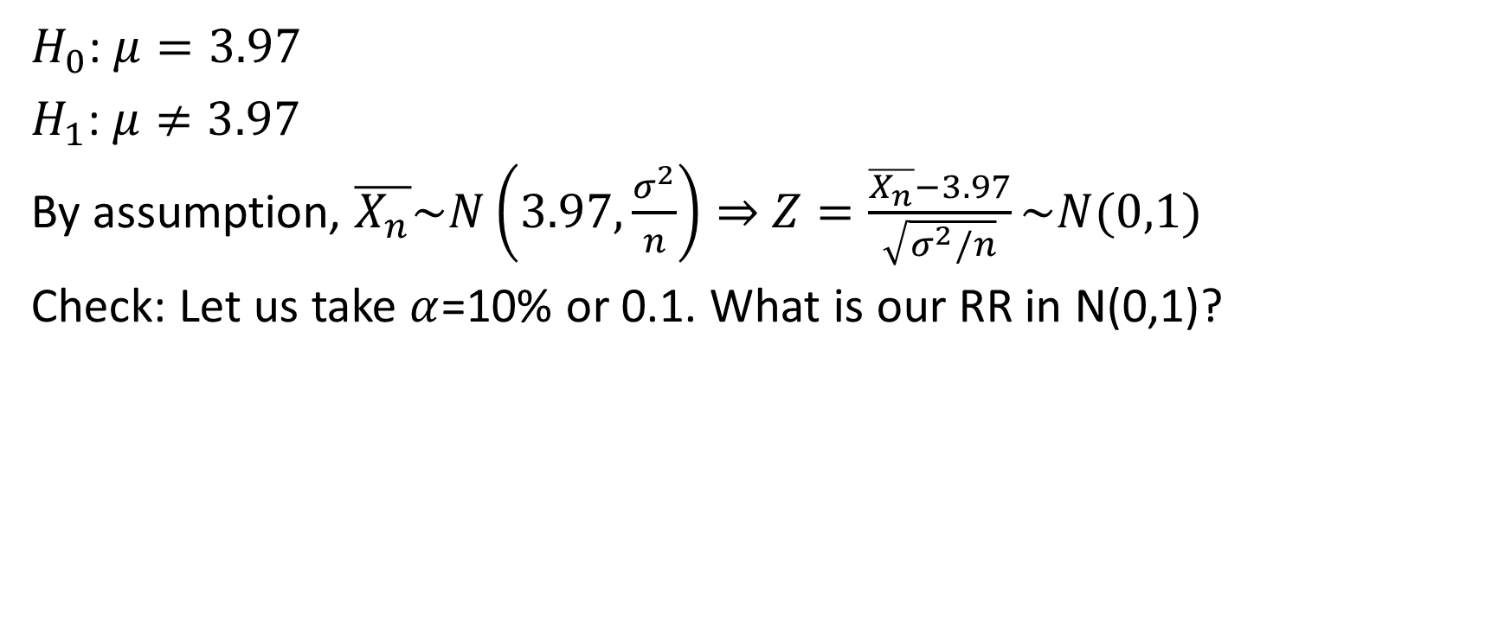
Example 1: Boston marathon
$H_{0}$: $μ=3.97$
$H_{1}$: $μ≠3.97$
By assumption, $\overline{X_{n}}\sim N\left(3.97,\frac{σ^{2}}{n}\right)⇒$ $Z=\frac{\overline{X_{n}}−3.97}{\sqrt{σ^{2}/n}}\sim N(0,1)$
Check: Let us take $α$=10% or 0.1. What is our RR in N(0,1)?

Slide 7
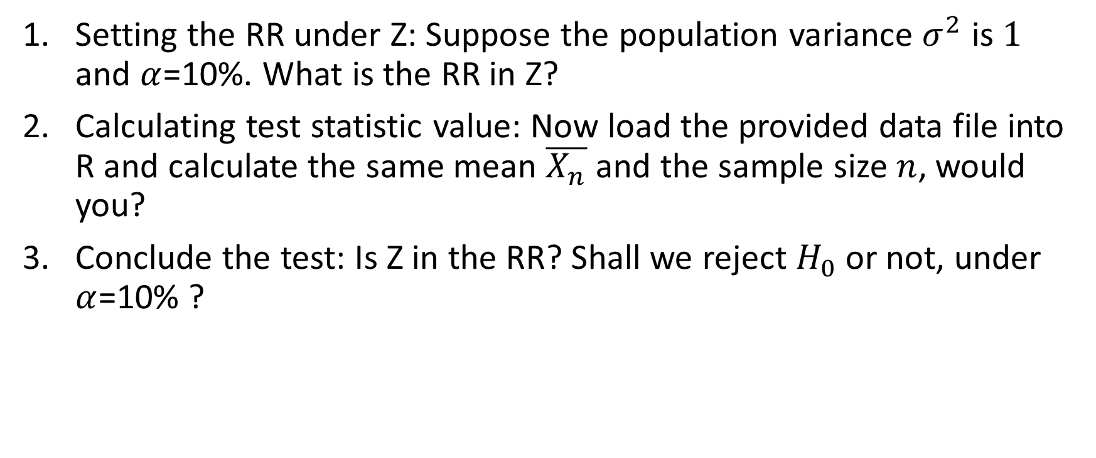
R calculations
Setting the RR under Z: Suppose the population variance $σ^{2}$ is $1$ and $α$=10%. What is the RR in Z?
Calculating test statistic value: Now load the provided data file into R and calculate the same mean $\overline{X_{n}}$ and the sample size $n$, would you?
Conclude the test: Is Z in the RR? Shall we reject $H_{0}$ or not, under $α$=10% ?

Slide 8
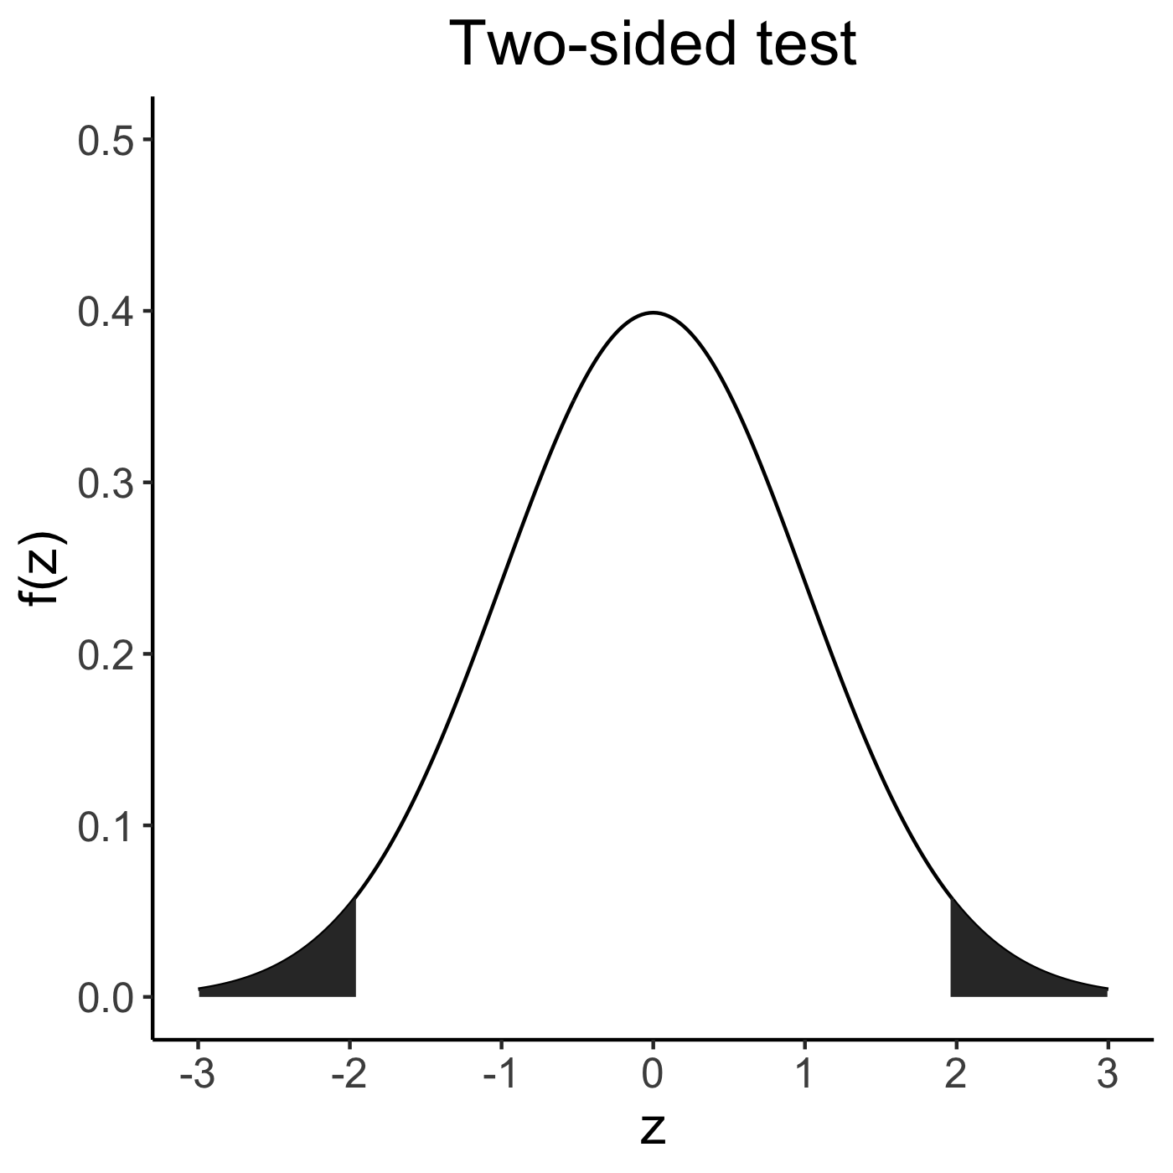
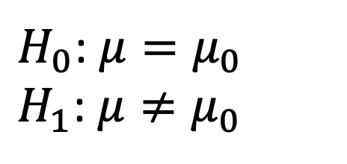

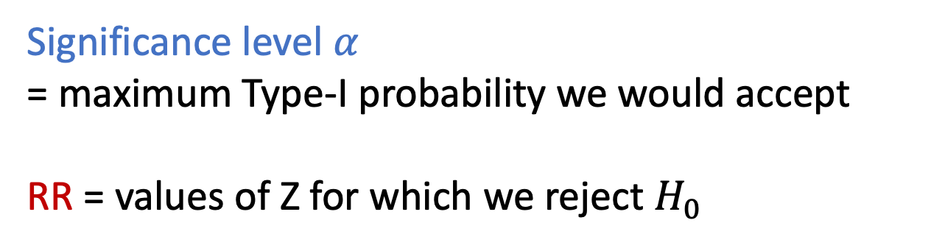

HT so far
$H_{0}$: $μ=μ_{0}$
$H_{1}$: $μ≠μ_{0}$
Under $H_{0}$,
$$Z=\frac{\overline{X_{n}}−μ_{0}}{\sqrt{σ^{2}/n}}\sim N(0,1)$$
Significance level 𝛼
= maximum Type-I probability we would accept
RR = values of Z for which we reject $H_{0}$
(-$∞, −1.96) ∪$ (1.96, $∞)$ for 𝛼 = 0.05

Slide 9
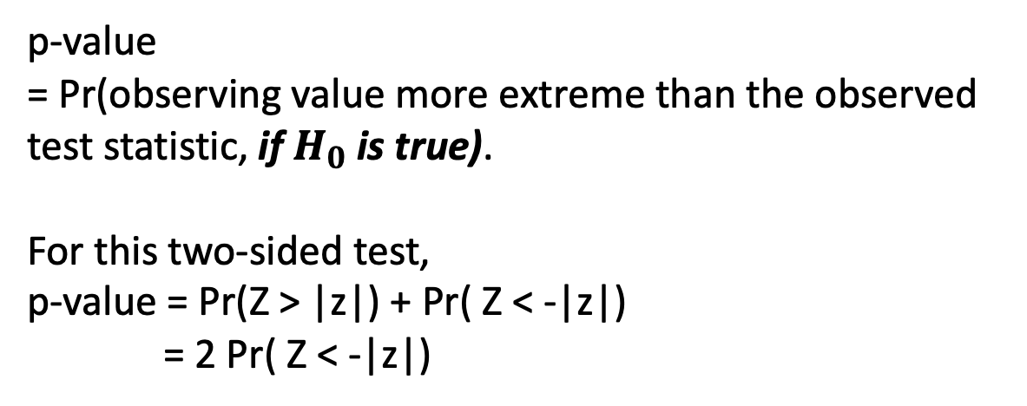


HT: evidence against H0
$H_{0}$: $μ=μ_{0}$
$H_{1}$: $μ≠μ_{0}$
p-value
= Pr(observing value more extreme than the observed test statistic, if $H_{0}$ is true).
For this two-sided test,
p-value = Pr(Z > |z|) + Pr( Z < -|z|) = 2 Pr( Z < -|z|)
$$−|z|$$
$$|z|$$
p-value

Slide 10
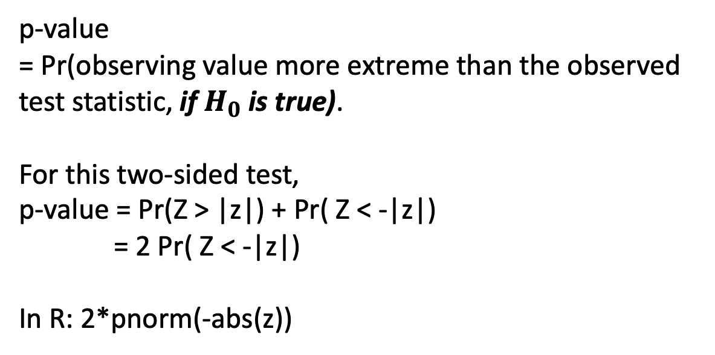
HT: evidence against H0
$H_{0}$: $μ=μ_{0}$
$H_{1}$: $μ≠μ_{0}$
p-value
= Pr(observing value more extreme than the observed test statistic, if $H_{0}$ is true).
For this two-sided test,
p-value = Pr(Z > |z|) + Pr( Z < -|z|) = 2 Pr( Z < -|z|)
In R: 2*pnorm(-abs(z))
$$−|z|$$
$$|z|$$

Slide 11
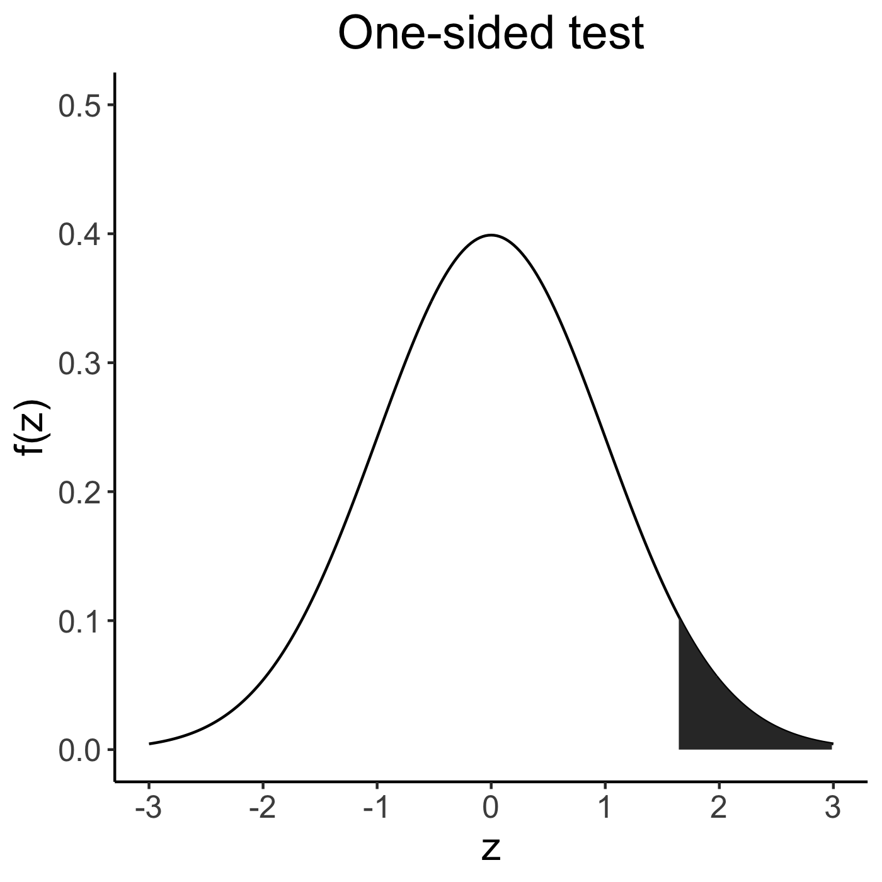
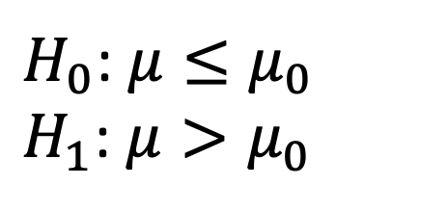
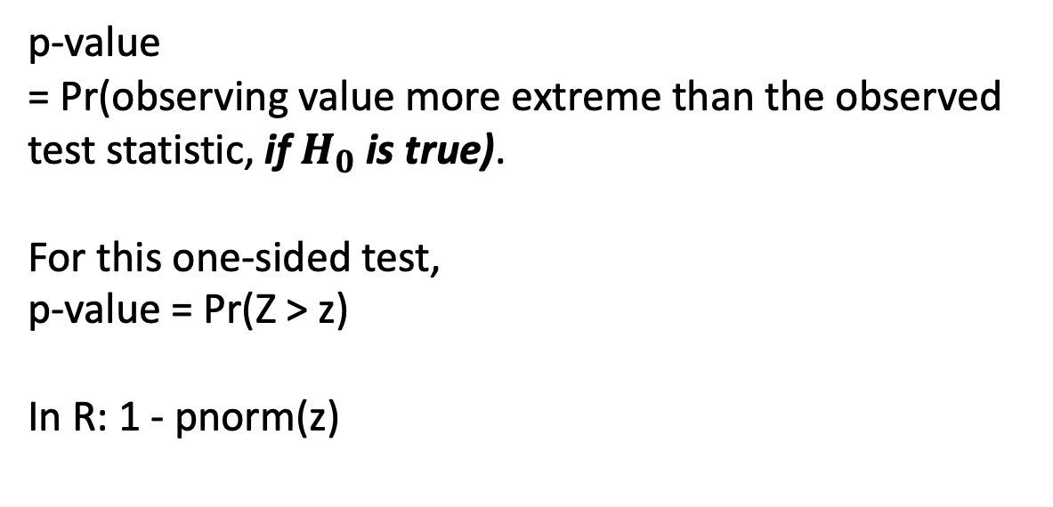

HT: evidence against H0
$H_{0}$: $μ≤μ_{0}$
$H_{1}$: $μ>μ_{0}$
p-value
= Pr(observing value more extreme than the observed test statistic, if $H_{0}$ is true).
For this one-sided test,
p-value = Pr(Z > z)
In R: 1 - pnorm(z)
$$z$$

Slide 12
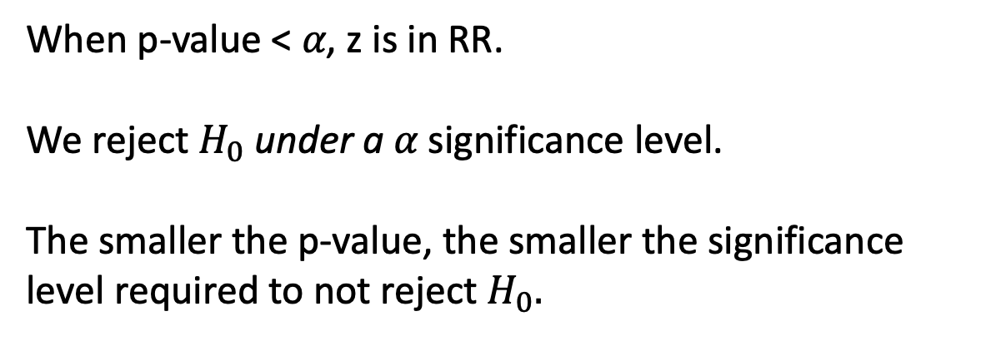
HT: evidence against H0
$H_{0}$: $μ=μ_{0}$
$H_{1}$: $μ≠μ_{0}$
When p-value < 𝛼, z is in RR.
We reject $H_{0}$ under a 𝛼 significance level.
The smaller the p-value, the smaller the significance level required to not reject $H_{0}.$
$$−|z|$$
$$|z|$$
p-value

Slide 13
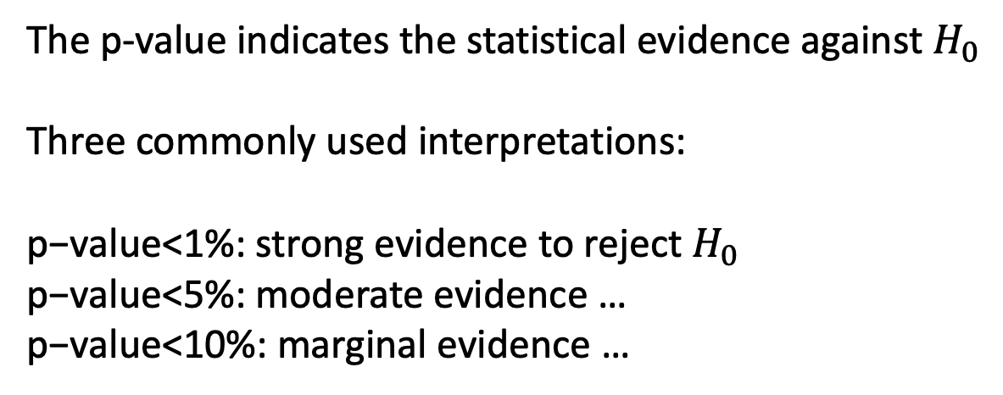
HT: evidence against H0
$H_{0}$: $μ=μ_{0}$
$H_{1}$: $μ≠μ_{0}$
The p-value indicates the statistical evidence against $H_{0}$
Three commonly used interpretations:
$\text{p}\text{−}\text{value}$<1%: strong evidence to reject $H_{0}$
$\text{p}\text{−}\text{value}$<5%: moderate evidence …
$\text{p}\text{−}\text{value}$<10%: marginal evidence …
$$−|z|$$
$$|z|$$

Slide 14
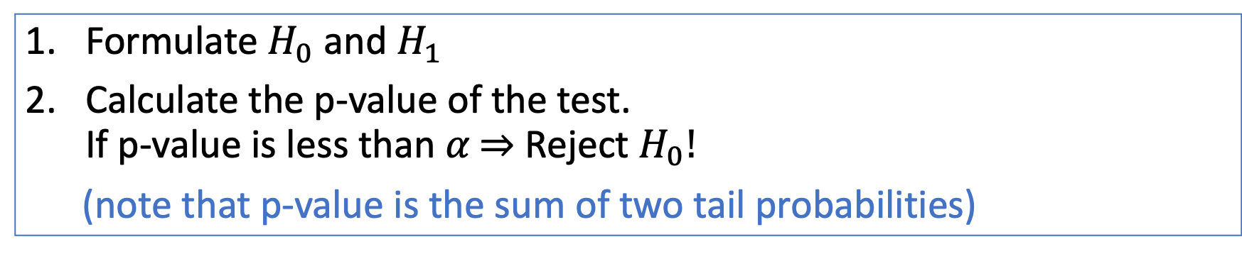
Summary for a two-sided test
Formulate $H_{0}$ and $H_{1}$
Calculate the p-value of the test. If p-value is less than 𝛼 $⇒$ Reject $H_{0}!$
(note that p-value is the sum of two tail probabilities)

Slide 15
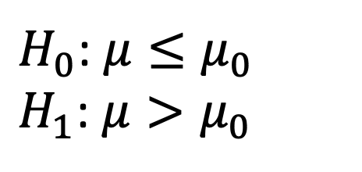
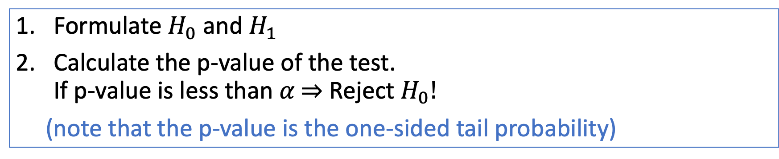
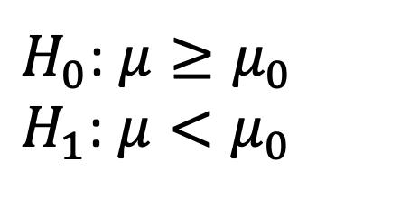
Summary for a one-sided test
Formulate $H_{0}$ and $H_{1}$
Calculate the p-value of the test. If p-value is less than 𝛼 $⇒$ Reject $H_{0}!$
(note that the p-value is the one-sided tail probability)
$H_{0}$: $μ≤μ_{0}$
$H_{1}$: $μ>μ_{0}$
$H_{0}$: $μ≥μ_{0}$
$H_{1}$: $μ<μ_{0}$
p-value = Pr(Z > z)
p-value = Pr(Z < z)

Slide 16
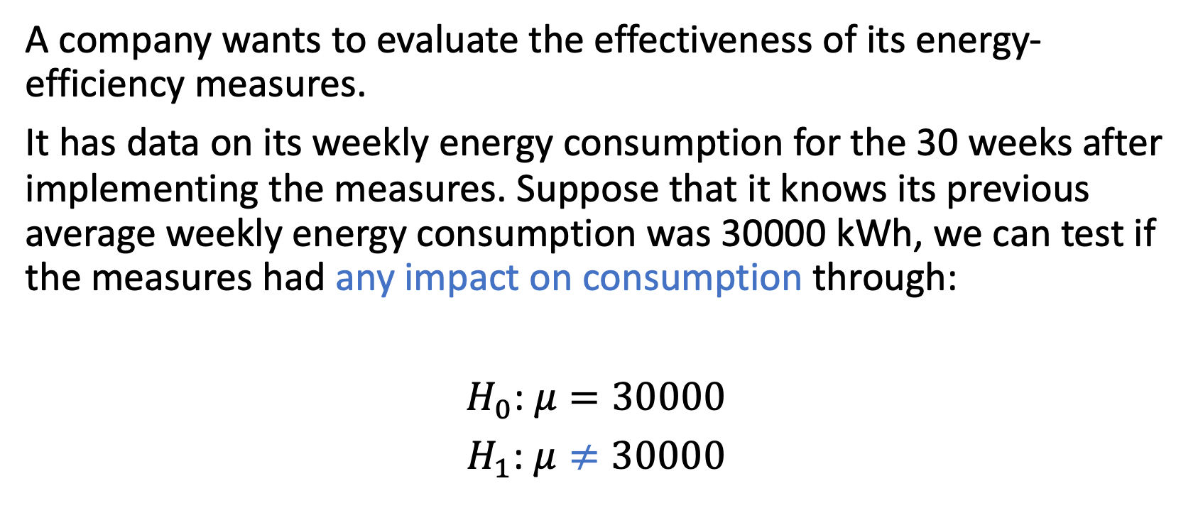
Worked example: Two-sided test
A company wants to evaluate the effectiveness of its energy-efficiency measures.
It has data on its weekly energy consumption for the 30 weeks after implementing the measures. Suppose that it knows its previous average weekly energy consumption was 30000 kWh, we can test if the measures had any impact on consumption through:
$H_{0}$: $μ=30000$
$H_{1}$: $μ≠30000$

Slide 17
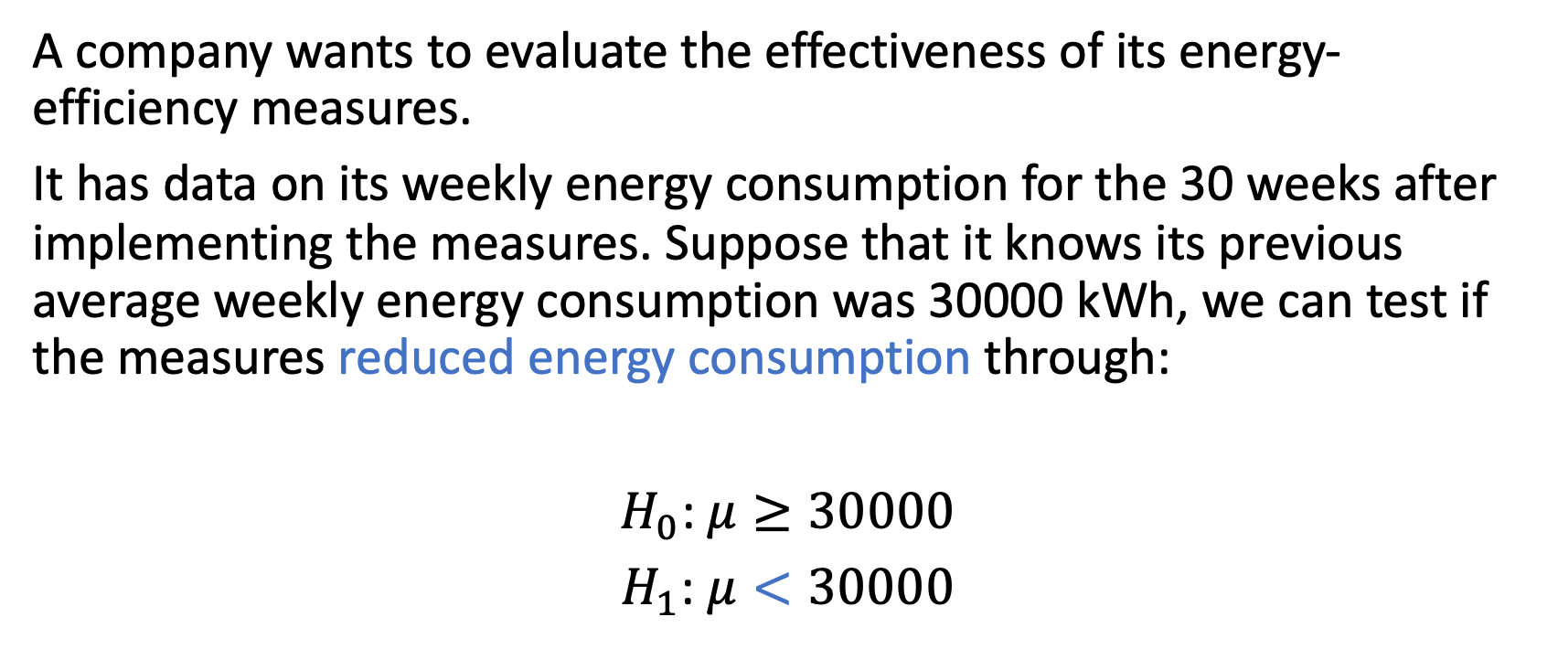
Worked example: One-sided test
A company wants to evaluate the effectiveness of its energy-efficiency measures.
It has data on its weekly energy consumption for the 30 weeks after implementing the measures. Suppose that it knows its previous average weekly energy consumption was 30000 kWh, we can test if the measures reduced energy consumption through:
$H_{0}$: $μ≥30000$
$H_{1}$: $μ<30000$

Slide 18

The population variance $σ^{2}$ could be and should be unknown in practice

Slide 19

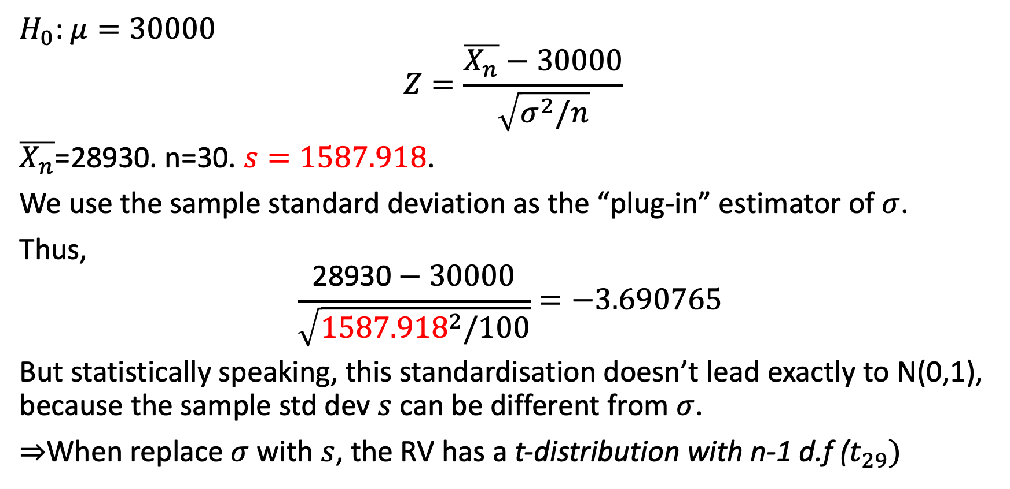
When $σ^{2}$ is not known, we estimate it!
$H_{0}$: $μ=30000$
$$Z=\frac{\overline{X_{n}}−30000}{\sqrt{σ^{2}/n}}$$
$\overline{X_{n}}$=28930. n=30. $s=1587.918$.
We use the sample standard deviation as the “plug-in” estimator of $σ$.
Thus,
$$\frac{\text{28930}−30000}{\sqrt{{1587.918}^{2}/100}}=−3.690765$$ But statistically speaking, this standardisation doesn’t lead exactly to N(0,1), because the sample std dev $s$ can be different from $σ$.
$⇒$When replace $σ$ with $s$, the RV has a t-distribution with n-1 d.f ($t_{29})$

Slide 20

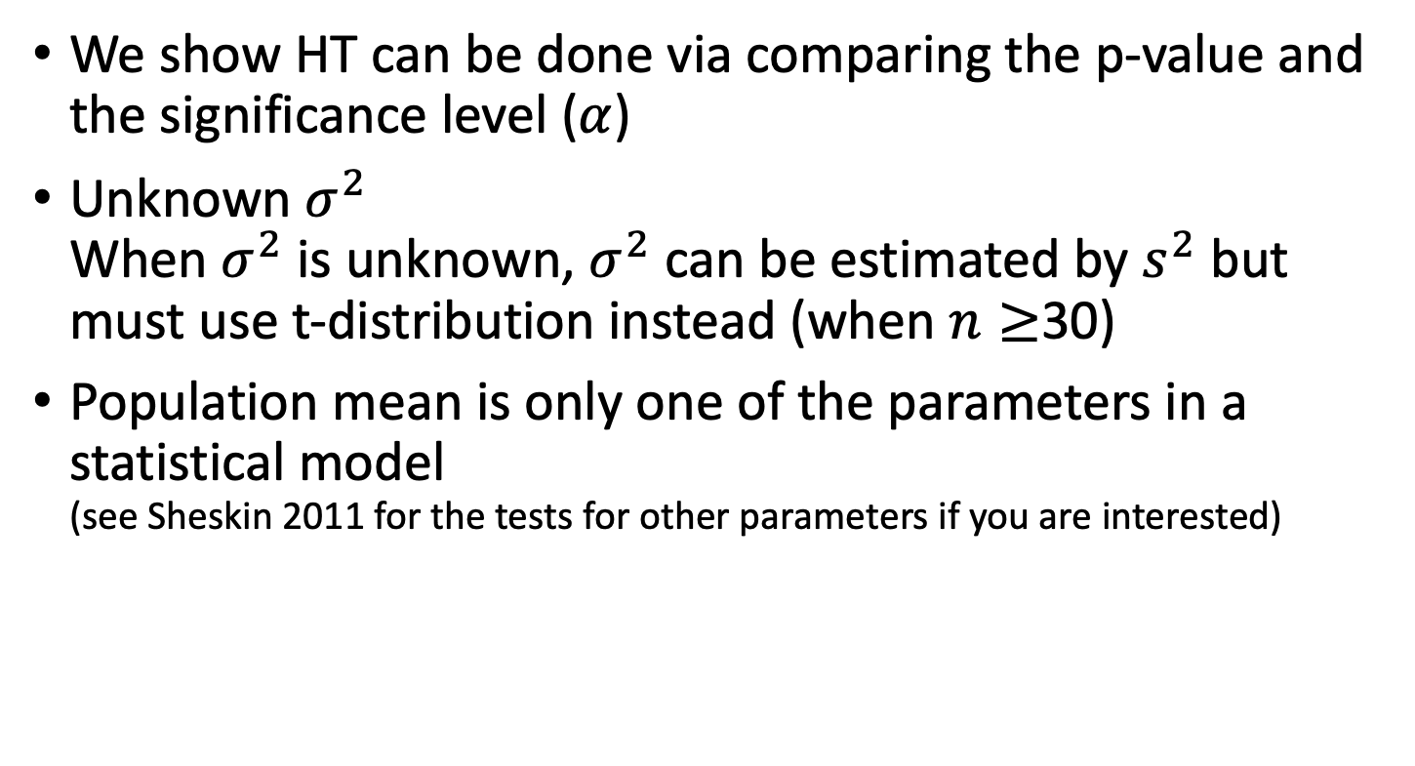
Summary
We show HT can be done via comparing the p-value and the significance level ($α$)
Unknown $σ^{2}$ When $σ^{2}$ is unknown, $σ^{2}$ can be estimated by $s^{2}$ but must use t-distribution instead (when $n≥$30)
Population mean is only one of the parameters in a statistical model (see Sheskin 2011 for the tests for other parameters if you are interested)

